Slide 1

Predicting Diabetes Using Machine Learning

Slide 2
ABSTRACT :
This report explores the development and implementation of predictive models for diabetes mellitus, focusing on the integration of machine learning techniques to enhance early diagnosis and management. Diabetes, a chronic metabolic disorder characterized by elevated blood glucose levels, poses significant health risks if not detected and managed early. The advent of predictive analytics in healthcare offers a promising avenue to mitigate these risks by leveraging patient data to forecast the likelihood of developing diabetes.
The study utilizes various machine learning algorithms, including logistic regression, decision trees, and neural networks, to analyze large datasets comprising demographic, clinical, and lifestyle factors. These models aim to identify patterns and correlations that are indicative of diabetes onset. The report delves into the data preprocessing steps, feature selection methods, and the evaluation metrics used to assess model performance.
Furthermore, the report highlights the challenges encountered in predictive modeling, such as data quality issues, class imbalance, and the interpretability of complex models. It also discusses the potential of incorporating real-time data from wearable devices and electronic health records to enhance prediction accuracy.
The findings underscore the efficacy of predictive models in identifying high-risk individuals, thereby facilitating timely interventions and personalized treatment plans. This proactive approach can significantly reduce the burden of diabetes on healthcare systems and improve patient outcomes. The report concludes with recommendations for future research and the implementation of predictive analytics in clinical

Slide 3
TABLE OF CONTENT:
Executive Summary
Introduction and Objective
Methodology
Predictive Models for Diabetes
Case Studies
Implementation and Interpretation
Existing Method
Discussion
Conclusion
References

Slide 4
Executive Summary: Diabetes Prediction Using Machine Learning:
Overview:
Diabetes mellitus is a prevalent chronic condition characterized by elevated blood glucose levels, which can lead to serious health complications if not managed timely. Early detection and intervention are crucial for preventing the progression of diabetes and improving patient outcomes. This report explores the application of machine learning techniques to develop predictive models that can identify individuals at high risk of developing diabetes. By leveraging demographic, clinical, and lifestyle data, these models aim to facilitate early diagnosis and personalized treatment plans.
The study demonstrates the potential of machine learning models in predicting diabetes risk. The Random Forest model emerged as the most effective, offering a combination of high accuracy and interpretability. This predictive capability enables healthcare providers to identify high-risk individuals early and implement timely interventions, ultimately improving patient outcomes and reducing the burden on healthcare systems.

Slide 5
Introduction:
Diabetes mellitus is a chronic metabolic disorder characterized by elevated blood glucose levels, posing significant health risks if not managed promptly. Predictive analytics offers a proactive approach to identify individuals at risk of developing diabetes early on, thereby enabling timely interventions and personalized treatments.
Diabetes mellitus is a chronic metabolic disorder characterized by elevated levels of blood glucose, which can lead to severe health complications such as cardiovascular disease, nerve damage, kidney failure, and blindness if not managed properly. According to the World Health Organization (WHO), the prevalence of diabetes is rising globally, with significant impacts on individuals' quality of life and substantial burdens on healthcare systems.
Objectives :
The primary objective of this report is to explore the development and implementation of predictive models for diabetes mellitus. Specifically, the report focuses on integrating machine learning techniques to enhance the early diagnosis and management of diabetes. The key goals include:
Reviewing existing methods used for diabetes prediction.
Proposing a novel approach with improved architecture for better prediction accuracy.
Detailing the methodology for data collection, preprocessing, model selection, and evaluation.
Implementing the proposed predictive models and assessing their performance.
Discussing the challenges and limitations associated with predictive modeling in diabete

Slide 6
Methodology for Predictive Diabetes Modeling :
Problem Definition and Data Collection:
The primary objective is to predict the onset of diabetes in individuals based on various demographic, clinical, and lifestyle
2. Data Pre-processing:
Normalization/Standardization: Ensuring features are on a similar scale using techniques like Min-Max scaling or Z-score normalization.
Encoding Categorical Variables: Converting categorical data into numerical format using one-hot encoding or label encoding.
3. Model Selection:
Decision Trees: For simple, interpretable models.
Random Forests: For improved accuracy and robustness through ensemble learning.
Support Vector Machines (SVMs): For handling high-dimensional data and complex relationships.
4. Model Training and Evaluation:
Model Training: Training each selected model on the training dataset, using appropriate algorithms and tuned hyper parameters.
Evaluation Metrics:
Accuracy: Proportion of true results among the total cases examined.
Precision: Proportion of true positive results among all positive results predicted by the model.
Recall (Sensitivity): Proportion of true positive results among all actual positive cases.
F1-Score: Harmonic mean of precision and recall, providing a balance between the two.

Slide 7
7. Documentation and Reporting:
Documentation:
Documenting all processes, including data preprocessing steps, model selection criteria, hyperparameter tuning, and evaluation metrics.
Reporting:
Preparing detailed reports and visualizations to communicate the methodology, results, and insights to stakeholders, healthcare providers, or researchers.
Predictive Model for Diabetes Prediction:
This section presents the implementation of various machine learning models for predicting diabetes. We will focus on three key models: Decision Trees, Random Forests, and Support Vector Machines (SVMs). We will also provide code snippets for each model using Python's scikit-learn library.
Data Preparation 2. Decision Tree Model 3. Random Forest Model
4. Support Vector Machine (SVM) Model 5. Model Comparison and Selection 6. Model Interpretation
6. Model Interpretation 7. Model Deployment 8.Model Monitoring and Updates

Slide 8
Case Study :
Diabetes mellitus is a chronic condition characterized by elevated blood glucose levels, which can lead to serious health complications if not managed properly. Early detection and intervention are crucial in mitigating the adverse effects of diabetes. This case study explores the application of predictive analytics in identifying individuals at high risk of developing diabetes using machine learning models. By leveraging demographic, clinical, and lifestyle data, we aim to develop robust predictive models that can assist healthcare providers in early diagnosis and management.
Implementation and Interpretation :
In this section, we focus on the practical aspects of implementing the predictive models for diabetes and interpreting their outcomes. We will use Python's scikit-learn library for the implementation. The models we will work with are Decision Trees, Random Forests, and Support Vector Machines (SVMs).
This implementation shows how different machine learning models can be used to predict diabetes, with each model offering distinct advantages and interpretability. Decision Trees are easy to understand but may over fit. Random Forests provide better accuracy and robustness through ensemble learning. SVMs are powerful for high-dimensional data but require careful tuning.
By interpreting the results using confusion matrices, classification reports, and feature importance, healthcare professionals can make informed decisions based on the model's predictions, ultimately leading to better patient outcomes.

Slide 9






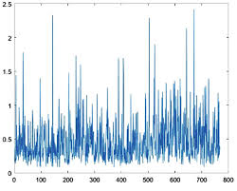

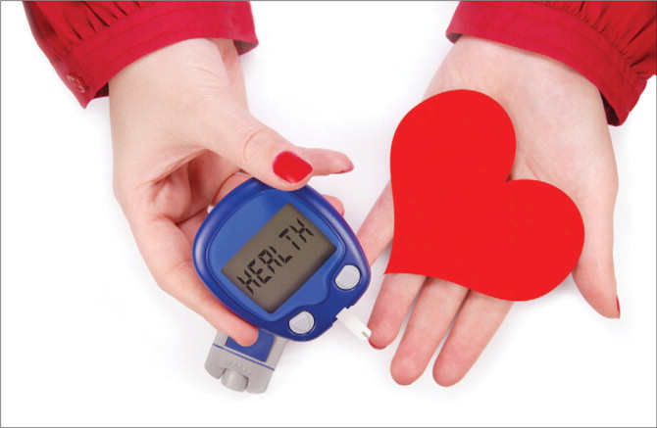
Diabetes Datasets
Pregnancies Glucose Blood Pressure
Skin Thickness Insulin BMI(Body Mass Index)
DiabetesPedigreeFunction Age Outcome

Slide 10
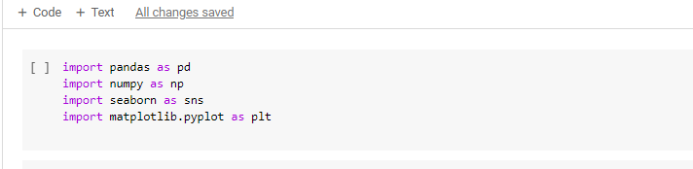
Import Pandas as pd : Pandas is a powerful and flexible data manipulation and analysis library for Python. It provides data structures like Data Frames and Series, which are essential for handling structured data (like tables in a database or Excel spreadsheets).
Import Numpy as np : NumPy is a core library for numerical and scientific computing in Python. It provides support for arrays, matrices, and many mathematical functions to operate on these data structures.
Import Seaborn as sns : Seaborn is a statistical data visualization library built on top of Matplotlib. It provides a high-level interface for drawing attractive and informative statistical graphics.
import matplotlib.pyplot as plt : Matplotlib is a comprehensive library for creating static, animated, and interactive visualizations in Python. The pyplot module is a state-based interface to Matplotlib, similar to MATLAB, making it easy to create plots.

Slide 11
diabetes.head() : The head method is used to display the first few rows of a Data Frame or Series. By default, it shows the first 5 rows, but you can specify the number of rows you want to see by passing an integer as an argument.
diabetes.tail() : The tail() method returns the last n rows of a Data Frame or Series. By default, n is set to 5, meaning the method will return the last five rows if no argument is provided.
diabetes.columns : A column is a fundamental component of a Data Frame, representing a variable or feature with data values of a specific type. Columns allow you to perform various data operations and analyses efficiently.
diabetes.info() : The info() method provides a concise summary of the Data Frame. This summary includes useful information about the Data Frame's structure, which can help in understanding the nature and quality of the data.
diabetes.describe() : To generate descriptive statistics that summarize the central tendency, dispersion, and shape of a dataset’s distribution, excluding NaN values.
diabetes.describe().T : Transposing an array means converting the array's rows into columns and columns into rows.
diabetes.isnull() : The isnull() function is used to detect missing (NaN or None) values in a pandas Data Frame or Series. It returns a Data Frame or Series of the same shape as the input, where each entry is a boolean value: True if the value is missing, and False otherwise.
diabetes.isna().sum() :It helps in understanding the data quality and identifying columns with missing data that may need further handling, such as imputation or removal of missing values.
diabetes.duplicated().sum() : It's a quick way to identify and quantify duplicates within your dataset.

Slide 12
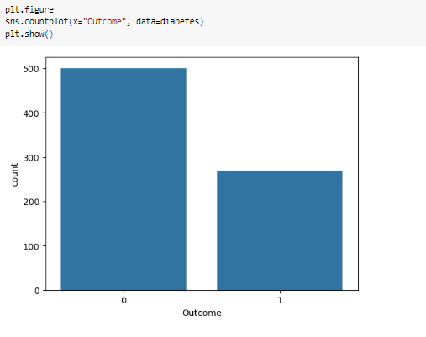
INTERPRETATION :
The bar chart depicts the distribution of the 'Outcome' variable from a dataset labeled 'diabetes'. The 'Outcome' variable has two possible values: 0 and 1. The x-axis represents these two outcomes, while the y-axis quantifies their respective counts.
Count of Outcome 0 (Non-diabetic): The bar on the left, which corresponds to 'Outcome' 0, has a height suggesting there are approximately 500 non-diabetic cases in the dataset.
Count of Outcome 1 (Diabetic): The bar on the right represents 'Outcome' 1, indicating there are around 250 diabetic cases.
The dataset is imbalanced, with a higher number of non-diabetic instances (Outcome 0) compared to diabetic instances (Outcome 1). The ratio appears to be roughly 2:1. This imbalance is an important consideration for any statistical analysis or machine learning models built using this data, as it might affect the performance and require techniques to handle imbalanced data.

Slide 13
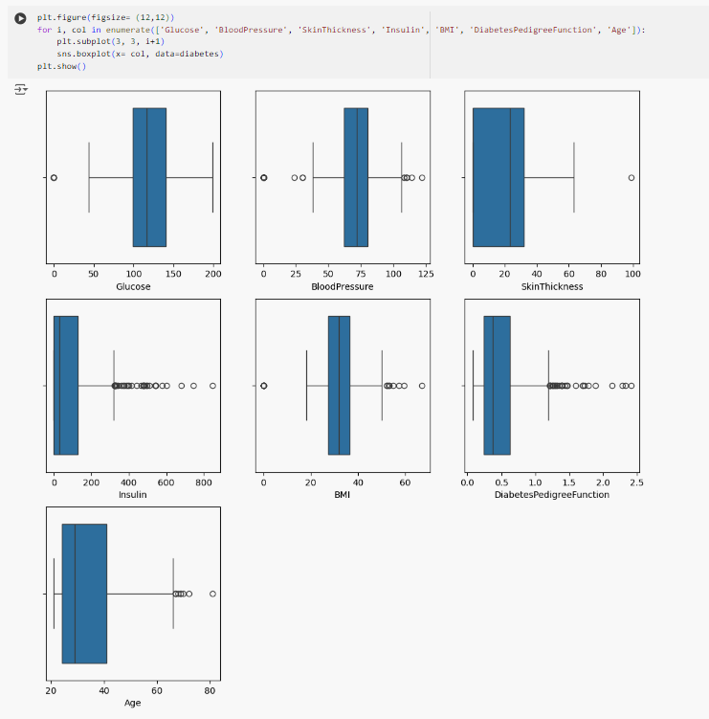
INTERPRETATION :
Glucose:
The median glucose level is around 120.
The interquartile range (IQR) is approximately between 100 and 150.
There are a few outliers below 50 and above 200, indicating some extreme values in the dataset.
Blood Pressure:
The median blood pressure is around 70.
The IQR is approximately between 60 and 80.
There are several outliers below 40 and above 100, suggesting variability in blood pressure measurements.
Skin Thickness:
The median skin thickness is around 25.
The IQR is approximately between 20 and 35.
There are a few outliers above 60, indicating some extreme values.
Insulin:
The median insulin level is around 100.
The IQR is approximately between 50 and 150.
There are numerous outliers above 200, with some values reaching up to 800, indicating significant variability and extreme values in insulin levels.
BMI (Body Mass Index):
The median BMI is around 30.
The IQR is approximately between 25 and 35.
There are several outliers above 50, suggesting some extreme BMI values.
Diabetes Pedigree Function:
The median diabetes pedigree function value is around 0.5.
The IQR is approximately between 0.3 and 0.7.
There are several outliers above 1.5, indicating some extreme values.
Age:
The median age is around 30.
The IQR is approximately between 25 and 40.
There are a few outliers above 60, suggesting some older individuals in the dataset.

Slide 14
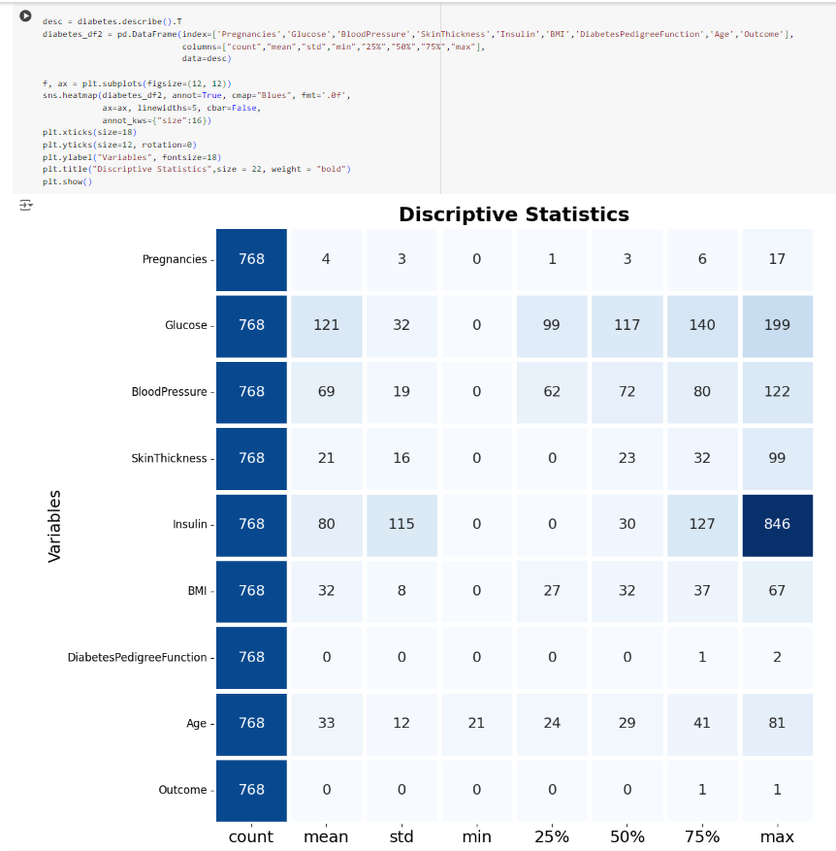
INTERPRETATION :
This image presents descriptive statistics of a diabetes dataset using a heat map. The dataset includes various health indicators such as Pregnancies, Glucose, Blood Pressure, SkinThickness, Insulin, BMI, DiabetesPedigreeFunction, Age, and Outcome, with each having a count of 768 entries. Key statistics like mean, standard deviation (std), minimum (min), 25th percentile (25%), median (50%), 75th percentile (75%), and maximum (max) values are displayed for each variable.
The heat map visualizes these statistics, where darker shades indicate higher values. For instance, the maximum insulin value is notably high at 846, represented by the darkest blue. This visual aid helps in quickly identifying the range and distribution of each variable in the dataset.
In conclusion, the heat map efficiently summarizes essential descriptive statistics, providing a comprehensive overview of the dataset's characteristics, which is crucial for further data analysis and interpretation.

Slide 15
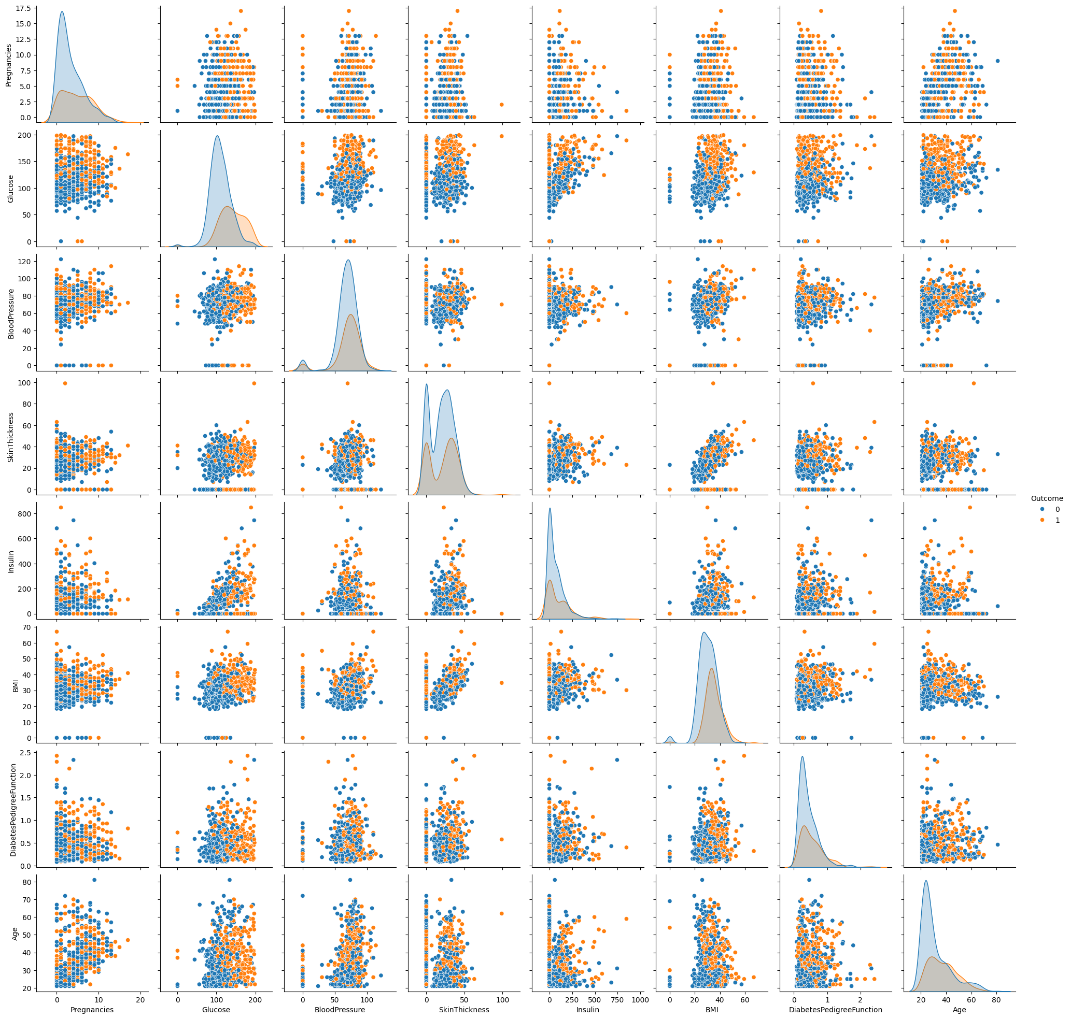

Slide 16
INTERPRETATION :
The image displays a paired scatter plot matrix augmented with histograms and KDE (Kernel Density Estimation) plots along the diagonals. The data points represent various attributes related to health metrics, and are segregated by color to indicate two different outcomes, likely associated with a binary classification such as the presence or absence of diabetes (Outcome 0 and Outcome 1).
Key Observations:
Diagonal Elements:
The histograms/KDE plots along the diagonal illustrate the distribution of each attribute. For example, attributes like "Age" and "BMI" show distinct variations between the two outcomes.
Scatter Plot Analysis:
Off-diagonal elements display bivariate relationships between different attributes. The scatter plots reveal how pairs of attributes interact differently based on the outcome.
For example, the scatter plots between "Glucose" and "Insulin", and "BMI" and "Skin Thickness" show notably distinct clustering, hinting at possible predictive correlations.
Pairwise Comparisons:
Each row and column pair comparison provides insight into the individual and combined behavior of features depending on the outcome. For instance, higher "Glucose" and "Insulin" levels seem to be associated with Outcome 1.
The scatter plot matrix serves as an exploratory data analysis tool, illustrating how various health attributes interrelate and differentiating patterns based on outcomes. Key attributes like Glucose, BMI, and Age exhibit noticeable differences between the outcomes. This graphical representation highlights potential features that could be significant in predicting health outcomes, such as diabetes. These insights are crucial for further statistical modeling and developing predictive algorithms.

Slide 17
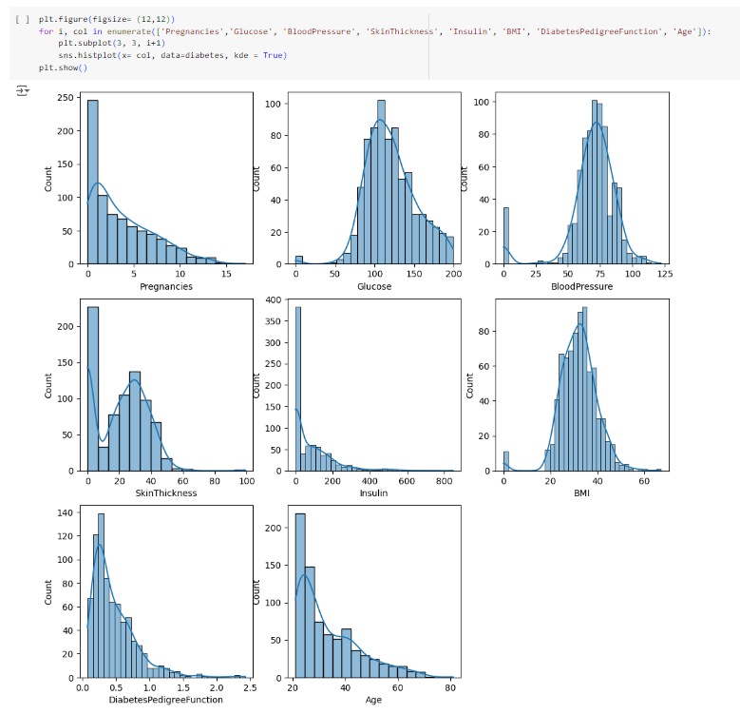
INTERPRETATION :
Pregnancies – The first histogram shows the distribution of the number of pregnancies. Most women have fewer than 5 pregnancies, with a steep drop-off thereafter.
Glucose – The glucose histogram resembles a normal distribution, concentrated around the mean value of about 100. There is a small representation of higher glucose levels, indicating potential diabetes cases.
Blood Pressure – Blood Pressure readings are centered around 75mmHg. This histogram is also bell-shaped, implying a relatively normal distribution of blood pressure values in the population.
SkinThickness – Skin thickness values are predominantly below 50, with the data showing a right-skew. The majority of individuals have lower skin thickness measurements.
Insulin – Insulin levels are highly right-skewed, with the majority of values at the lower end. A very small number of individuals have extremely high insulin levels, represented as a long tail.
BMI – The distribution of Body Mass Index (BMI) peaks around 30, indicating many individuals have a BMI in the overweight or obese range, which is a risk factor for diabetes.
DiabetesPedigreeFunction – The diabetes pedigree function values are mostly below 1.0, showing a right-skewed distribution. This metric often indicates the genetic likelihood of diabetes, with most people having a lower likelihood.
Age – The age distribution is also right-skewed, with a notable concentration of individuals between 20 and 50 years old. Few individuals are above 60 years of age.
Each histogram is supplemented with a Kernel Density Estimate (KDE) line to smooth out the distributions and highlight their underlying trends. Overall, these visualizations provide a comprehensive look into the characteristics of the individuals in the dataset, presenting a clear picture of factors associated with diabetes.

Slide 18
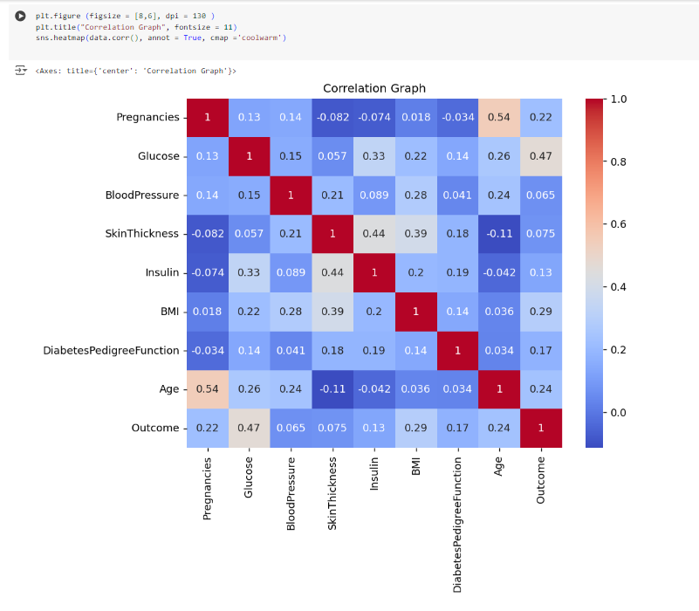
INTERPRETATION :
The provided image is a heat map illustrating the correlation matrix between various health-related variables and the outcome variable. The color scale on the right side of the heat map ranges from blue to red, with blue indicating low or negative correlations and red indicating high positive correlations. The key elements and relationships among the variables are discussed below:
Diagonal Line (Self-correlation): The diagonal line of the matrix (where each variable correlates with itself) shows a perfect correlation value of 1, which is expected.
High Correlation Values:
Age and Pregnancies (0.54): Shows a moderate positive correlation, indicating that as age increases, the number of pregnancies tends to increase too.
Glucose and Outcome (0.47): Shows a noticeable correlation suggesting that higher glucose levels are associated with the outcome variable, likely indicating a higher probability of the related outcome (possibly diabetes).
Moderate Correlation Values:
SkinThickness and Insulin (0.44): Indicates a moderate positive correlation.
BMI and SkinThickness (0.39): Suggests that higher BMI tends to go along with higher skin thickness measurements.
Low to Negligible Correlation Values:
Blood Pressure and Outcome (0.065): Shows a very low correlation with the outcome.
SkinThickness and Pregnancies (-0.082): Exhibits a negligible negative correlation.
Glucose has relatively strong correlations with multiple variables such as Insulin (0.33) and Age (0.26), indicating its overall importance in the dataset.

Slide 19
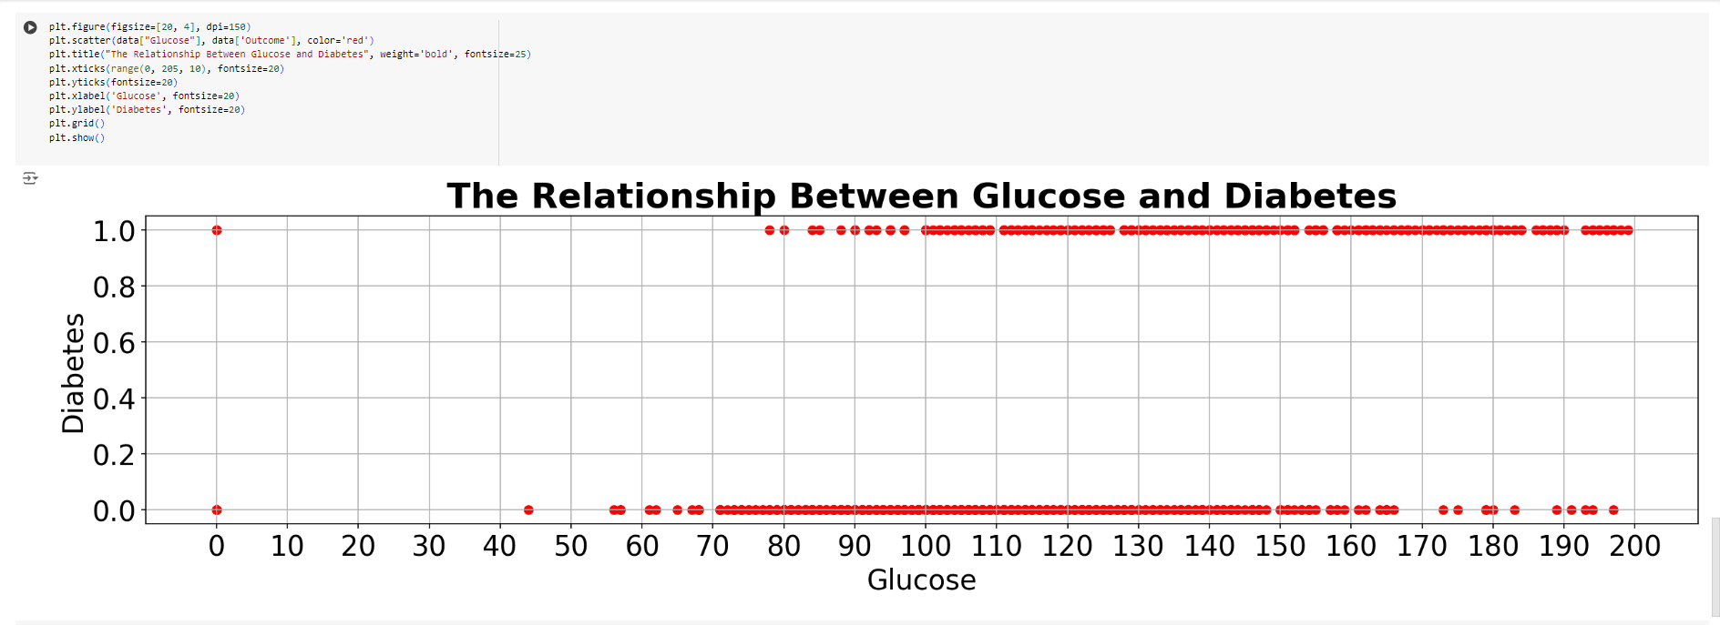
INTERPRETATION : The scatter plot illustrates the relationship between glucose levels and diabetes outcomes. The x-axis represents glucose levels ranging from 0 to 200, and the y-axis represents diabetes outcomes, categorized as 0 (non-diabetic) and 1 (diabetic). From the plot, we observe that higher glucose levels tend to correspond more frequently with a diabetes outcome of 1. In the glucose range from approximately 80 to 200, a significant proportion of data points are labeled as diabetic (1). Conversely, at lower glucose levels, particularly from 0 to 80, there are more scattered instances of non-diabetic outcomes (0), but there are still some diabetic cases present. There is a discernible trend showing that elevated glucose levels are associated with a higher likelihood of a diabetes diagnosis. This visual representation suggests that monitoring glucose levels could be a critical factor in understanding and predicting diabetes outcomes. Further statistical analysis would be necessary to quantify the strength of this association and to explore any underlying causal relationships

Slide 20
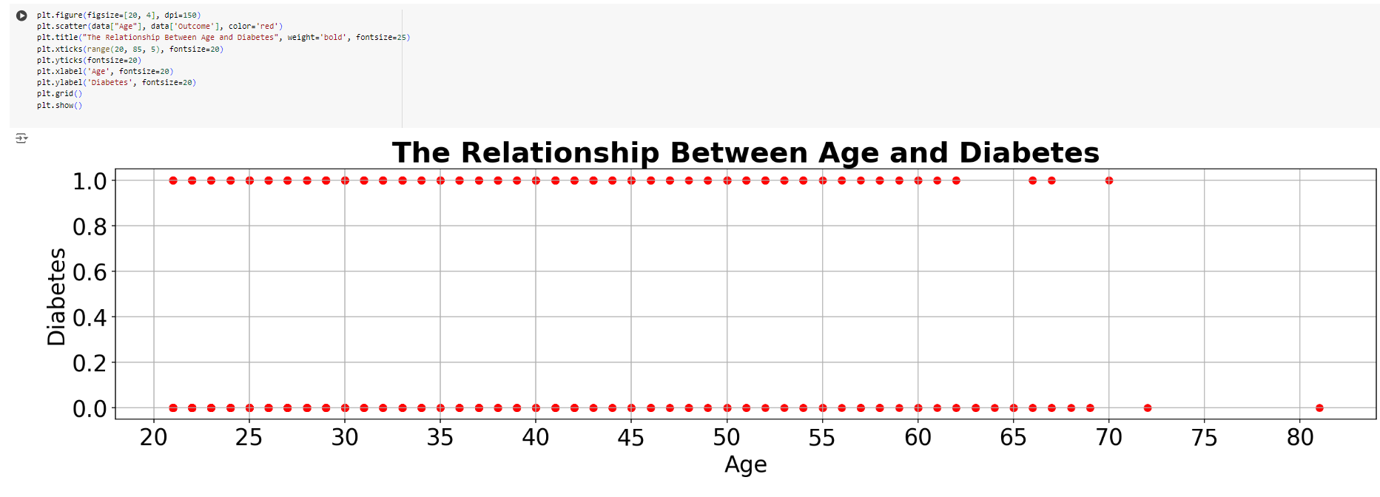
INTERPRETATION : The scatter plot titled "The Relationship Between Age and Diabetes" aims to visualize the correlation between age (plotted on the x-axis) and the incidence of diabetes (plotted on the y-axis). In this plot, the y-axis values are binary, with 0 representing the absence of diabetes and 1 representing the presence of diabetes. Data points are represented by red dots. From the plot, it is observed that there is no clear trend or correlation between age and diabetes. Individuals at all age groups from 20 to 80 appear distributed almost uniformly across both diabetes presence (1) and absence (0) without showing an age-dependent trend The scatter plot suggests that age alone does not have a definitive correlation with the presence of diabetes. Further investigation with additional variables or a larger dataset might be necessary to better understand the factors contributing to diabetes.

Slide 21
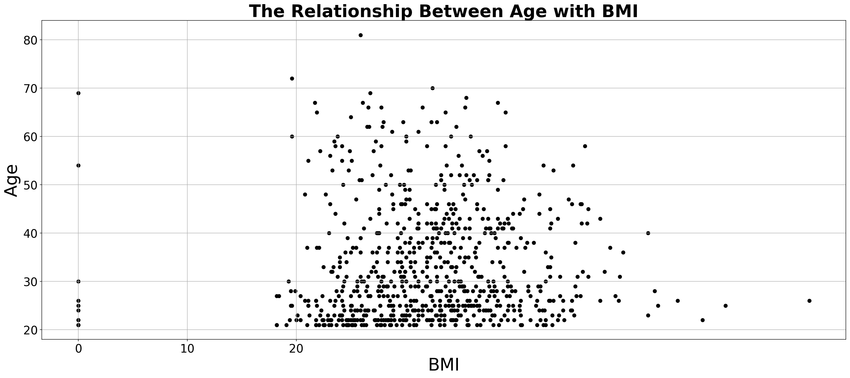
INTERPRETATION : The scatter plot illustrates the relationship between Age and Body Mass Index (BMI). As observed, the majority of the data points are clustered in the lower to mid-range of BMI values (approximately between 10 and 40). Most individuals, irrespective of age, have a BMI that falls within this range. Notably, age seems to span a wide range from around 20 to 80 years, with a dense concentration of individuals situated in the younger segment (roughly below 40 years of age). There are a few outliers in the dataset, indicating that some individuals have unusually low BMIs compared to others in the same age group. In conclusion, while age varies significantly, there appears to be a general trend that irrespective of age, BMI typically falls within a certain range. The relationship between age and BMI, as depicted, does not suggest a strong correlation since the points are widely dispersed. However, the presence of outliers and dense clustering in specific BMI ranges can inform more detailed investigations on influencing factors.

Slide 22
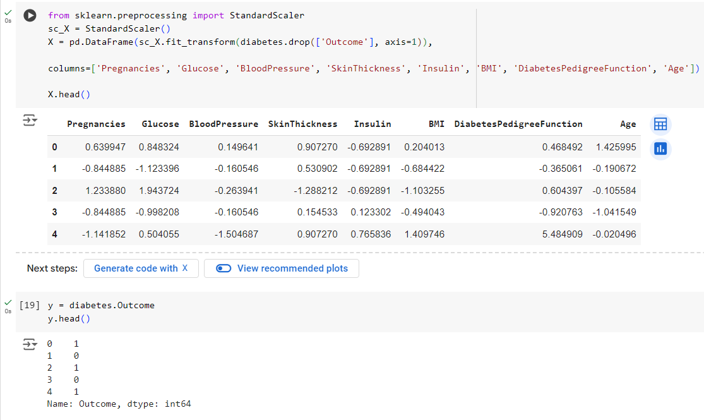
INTERPRETATION :
Imports and Scaling:
The StandardScaler from sklearn.preprocessing is imported and used to normalize the feature data.
The features (excluding the Outcome column) from the diabetes dataframe are scaled and a new dataframe X is created.
Column Assignment:
The column names for the new dataframe X are explicitly declared, representing various health metrics like 'Pregnancies', 'Glucose', 'Blood Pressure', 'Skin Thickness', 'Insulin', 'BMI', 'Diabetes Pedigree Function', and 'Age'.
Output of Scaled Features:
The head() method is used to display the first five rows of the scaled features dataset. The table provides a snapshot of the normalized values for each feature, assisting in checking the changes after scaling.
Extraction of Target Variable:
The Outcome column from the diabetes dataframe is separated and stored in the variable y.
The head() method displays the first five entries of the Outcome column, showing the binary classification (0 or 1), which likely indicates the presence or absence of diabetes.
Overall, this image illustrates the preparation stage where the features are normalized and the target variable is isolated in preparation for a machine learning task.

Slide 23
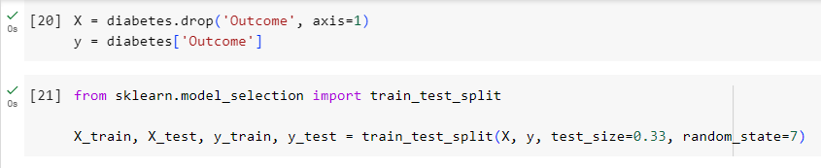
INTERPRETATION : The image shows a snippet of Python code used for data preprocessing and splitting a dataset for training and testing a machine learning model. The first part of the code (line 20) involves separating the target variable 'Outcome' from the rest of the dataset diabetes. The independent variables are stored in X and the target variable in y. The second part of the code (line 21) utilizes the train_test_split function from the sklearn.model_selection module. This function is used to split the dataset into training and testing subsets. The test_size=0.33 parameter indicates that 33% of the dataset will be allocated for testing, and the random_state=7 ensures the split will be reproducible by using a fixed random seed. The resulting splits are assigned to X_train, X_test, y_train, and y_test for further training and evaluation of the machine learning model.

Slide 24
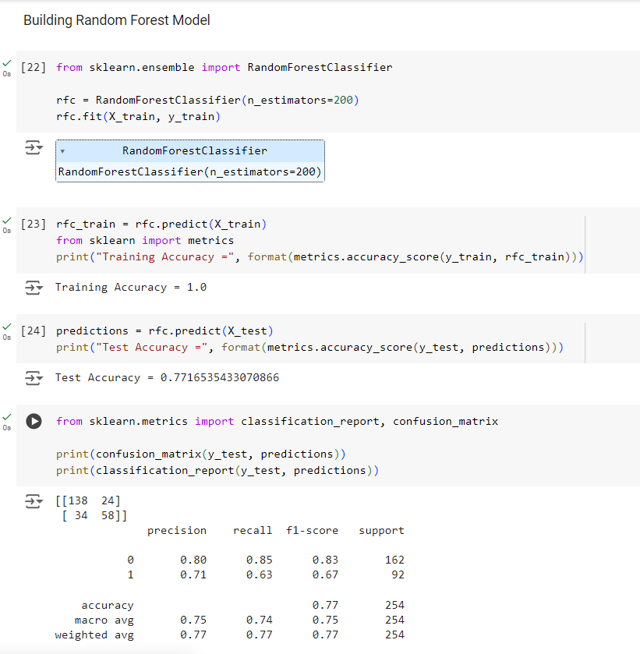
Random Forest Classifier Model

Slide 25
In this code, we are building a Random Forest classification model using the RandomForestClassifier from the sklearn.ensemble module. A Random Forest classifier with 200 decision trees (n_estimators=200) is trained on the training dataset (X_train, y_train). Here's a step-by-step analysis of the outputs:
Training the Model:
rfc = RandomForestClassifier(n_estimators=200)
rfc.fit(X_train, y_train)
This part initializes and trains the RandomForestClassifier with 200 estimators on the training data.
Evaluating Training Accuracy:
rfc_train = rfc.predict(X_train)
print("Training Accuracy =", format(metrics.accuracy_score(y_train, rfc_train)))
The model predictions on the training dataset (X_train) are evaluated, yielding a perfect accuracy of 1.0 (100%). This typically indicates that the model has fit the training data very well.
Evaluating Test Accuracy:
predictions = rfc.predict(X_test)
print("Test Accuracy =", format(metrics.accuracy_score(y_test, predictions)))
The predictions on the test dataset (X_test) result in an accuracy of approximately 0.771 (77.16%). While this is a decent accuracy, it's substantially lower than the training accuracy, suggesting potential overfitting.

Slide 26
Confusion Matrix and Classification Report:
from sklearn.metrics import classification_report, confusion_matrix
print(confusion_matrix(y_test, predictions))
print(classification_report(y_test, predictions))
The confusion matrix indicates the number of true positive, true negative, false positive, and false negative predictions. The classification report provides a detailed evaluation including precision, recall, and F1-score for each class.
Class 0:
Precision: 0.80
Recall: 0.85
F1-Score: 0.83
Class 1:
Precision: 0.71
Recall: 0.63
F1-Score: 0.67
These results show that the model performs better for Class 0 compared to Class 1, as evidenced by the higher precision, recall, and F1-score for Class 0. The overall weighted average metrics provide a comprehensive overview of the model's performance.
In summary, while the Random Forest model performs well on the training data, the test performance suggests some degree of overfitting. The classification metrics further highlight that the model has a higher prediction accuracy for one class over the other.

Slide 27
Model Building:
A Random Forest Classifier is created using 200 decision trees (n_estimators=200). The model is trained on the training dataset (X_train, y_train).
Model Evaluation on Training Data:
Predictions are made for the training data to evaluate the model's performance. The training accuracy is calculated and displayed, which is 1.0, indicating perfect accuracy on the training dataset.
Model Evaluation on Test Data:
The model is then tested on the test dataset (X_test). The test accuracy is calculated to be approximately 0.7717.
Detailed Metrics:
A confusion matrix and a detailed classification report are generated for the test dataset:
The confusion matrix shows the number of correct and incorrect predictions.
Classification report includes precision, recall, f1-score, and support for both classes (0 and 1).
The overall accuracy of the model on the test set is approximately 77%.
Class-wise performance:
Class 0: High precision (0.80), recall (0.85), and f1-score (0.83).
Class 1: Moderate precision (0.71), recall (0.63), and f1-score (0.67).
Macro and weighted averages for the metrics are also provided.
Conclusion:
The Random Forest model performs excellently on the training data, achieving perfect accuracy. However, it exhibits a slight drop in performance when evaluated on the test data, with an accuracy of approximately 77%. The classification report reveals that the model predicts Class 0 more accurately than Class 1, indicating a potential imbalance or difficulty in classifying the instances of Class 1. Further tuning or additional techniques might be needed to improve the model's performance, particularly for Class 1.

Slide 28
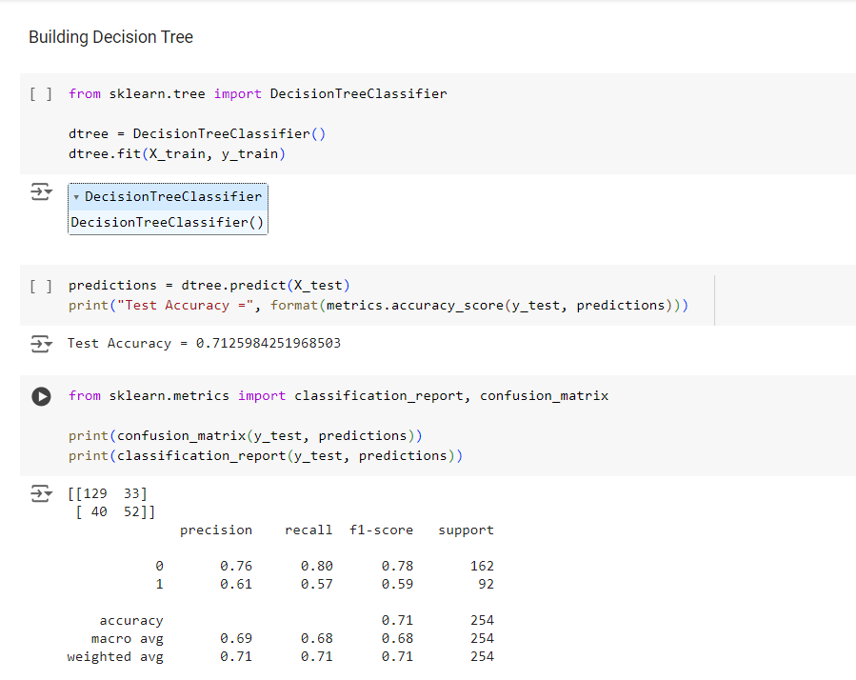
DECISION TREE MODEL

Slide 29
Model Training:
The DecisionTreeClassifier is imported from the sklearn.tree module.The model dtree is instantiated and then trained on the training data X_train and y_train using the fit method.
Model Testing and Accuracy:
The model is used to predict the labels for the test set X_test.The accuracy of the model is calculated using metrics.accuracy_score which compares the true labels y_test with the predicted labels predictions.The test accuracy is found to be approximately 71.26%
Confusion Matrix:
The confusion matrix is generated using confusion_matrix(y_test, predictions
The matrix:
[[129 33]
[ 40 52]]
indicates the following:
True Positive (TP): 129 False Positive (FP): 33
False Negative (FN): 40 True Negative (TN): 52
Classification Report:
The classification report is generated using classification_report(y_test, predictions), which provides detailed performance metrics:

Slide 30
Class 0:
Precision: 0.76
Recall: 0.80
F1-Score: 0.78
Support: 162
Class 1:
Precision: 0.61
Recall: 0.57
F1-Score: 0.59
Support: 92
Overall Metrics:
Accuracy: 0.71 (same as test accuracy)
Macro Average Precision: 0.69
Macro Average Recall: 0.68
Macro Average F1-Score: 0.68
Weighted Average Precision: 0.71
Weighted Average Recall: 0.71
Weighted Average F1-Score: 0.71

Slide 31
Conclusion:
The Decision Tree Classifier trained on the given dataset performs moderately well with a test accuracy of 71.26%. The confusion matrix and classification report provide deeper insights into the performance:
Class 0 (presumably the negative class) is predicted with higher precision (76%) and recall (80%), indicating that the model is more effective in identifying true negatives.
Class 1 (presumably the positive class) has lower precision (61%) and recall (57%), suggesting that the model has more difficulty correctly identifying true positives.
The weighted average metrics, which consider the support of each class, reflect an overall balanced performance, though with room for improvement, particularly in identifying Class 1 correctly.

Slide 32
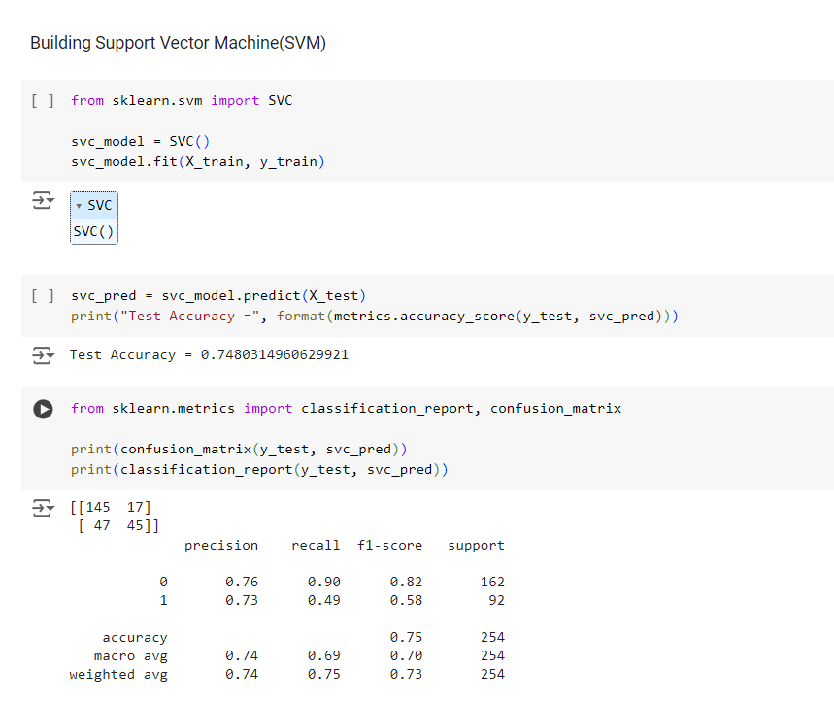
Support vector machine model

Slide 33
Model Training:
The SVC (Support Vector Classifier) is imported from the sklearn.svm module.The model svc_model is instantiated and then trained on the training data X_train and y_train using the fit method.
Model Testing and Accuracy:
The model is used to predict the labels for the test set X_test.The accuracy of the model is calculated using metrics.accuracy_score which compares the true labels y_test with the predicted labels svc_pred.The test accuracy is found to be approximately 74.80%.
Confusion Matrix:
The confusion matrix is generated using confusion_matrix(y_test, svc_pred
The matrix:
[[145 17]
[ 47 45]]
indicates the following:
True Positive (TP): 145 False Positive (FP): 17
False Negative (FN): 47 True Negative (TN): 45
Classification Report:
The classification report is generated using classification_report(y_test, svc_pred), which provides detailed performance metrics:

Slide 34
Class 0:
Precision: 0.76
Recall: 0.90
F1-Score: 0.82
Support: 162
Class 1:
Precision: 0.73
Recall: 0.49
F1-Score: 0.58
Support: 92
Overall Metrics:
Accuracy: 0.75 (same as test accuracy)
Macro Average Precision: 0.74
Macro Average Recall: 0.70
Macro Average F1-Score: 0.70
Weighted Average Precision: 0.74
Weighted Average Recall: 0.75
Weighted Average F1-Score: 0.73

Slide 35
Conclusion:
The Support Vector Machine Classifier trained on the given dataset performs moderately well with a test accuracy of 74.80%. The confusion matrix and classification report provide deeper insights into the performance:
Class 0:(presumably the negative class) is predicted with high precision (76%) and very high recall (90%), indicating that the model is highly effective in identifying true negatives.
Class 1:(presumably the positive class) has slightly lower precision (73%) and notably lower recall (49%), suggesting that the model has more difficulty correctly identifying true positives.
The weighted average metrics reflect an overall balanced performance with a slight preference towards Class 0 due to its higher support in the dataset.

Slide 36
Existing Method:
This section reviews current methodologies and predictive models used in diabetes prediction, highlighting their strengths and limitations. Common approaches such as logistic regression, decision trees, and support vector machines are discussed, along with their applications in clinical settings.
Decision Trees
Explanation: Decision Trees are hierarchical structures that use a series of binary decisions to classify data points. Each internal node represents a decision based on a feature, and each leaf node represents a class label (in this case, diabetes or non-diabetes).
Code (brief example in Python using scikit-learn):
from sklearn.tree import DecisionTreeClassifier
# Create a decision tree classifier
clf = DecisionTreeClassifier ()
# Train the classifier on training data X_train, y_train
clf.fit(X_train, y_train)
# Predict on test data X_test
y_pred = clf.predict(X_test)
Uses:
Decision Trees are straightforward to interpret and visualize.
They handle both numerical and categorical data.
Useful for identifying important features in the dataset that influence diabetes prediction.

Slide 37
Why we are using:
Decision Trees are useful for initial exploration of data and can provide insights into feature importance. They are suitable for scenarios where interpretability of the model is crucial.
2. Random Forests
Explanation: Random Forests are an ensemble learning method that builds multiple decision trees and combines their predictions to improve accuracy and reduce overfitting.
Code (brief example in Python using scikit-learn):
from sklearn.ensemble import RandomForestClassifier
# Create a random forest classifier
clf = RandomForestClassifier(n_estimators=100)
# Train the classifier on training data X_train, y_train
clf.fit(X_train, y_train)
# Predict on test data X_test
y_pred = clf.predict(X_test)
Uses:
Random Forests handle large datasets with high dimensionality effectively.
They reduce variance and overfitting compared to single decision trees.
Useful for improving predictive performance in diabetes prediction tasks.

Slide 38
Why we are using:
Random Forests combine the strengths of multiple decision trees to provide robust predictions. They are suitable when high accuracy and generalization to unseen data are important.
3. Support Vector Machines (SVMs)
Explanation: Support Vector Machines (SVMs) are powerful supervised learning models used for classification tasks. They find the hyperplane that best separates classes in a high-dimensional space.
Code (brief example in Python using scikit-learn):
from sklearn.svm import SVC
# Create a support vector classifier
clf = SVC(kernel='linear')
# Train the classifier on training data X_train, y_train
clf.fit(X_train, y_train)
# Predict on test data X_test
y_pred = clf.predict(X_test)
Uses:
SVMs are effective in cases where the decision boundary is complex or nonlinear.
They can handle high-dimensional data well, including in scenarios where feature space is not linearly separable.
Useful for diabetes prediction when the relationship between features and outcomes is complex.

Slide 39
Why we are using:
SVMs maximize the margin between classes, making them robust against overfitting and effective in high-dimensional spaces. They are suitable for scenarios where traditional linear models may not perform well.
. Proposed Method with Architecture
A novel architecture for diabetes prediction is proposed, integrating advanced machine learning algorithms with enhanced data pre-processing techniques. The architecture aims to improve prediction accuracy by leveraging demographic, clinical, and lifestyle data effectively.
The proposed method integrates multiple machine learning models to predict diabetes, utilizing a structured approach from data collection to deployment. Each step ensures the integrity and robustness of the predictive model, enabling healthcare providers to make informed decisions and provide timely interventions. The Random Forest model, with its superior accuracy and balanced performance metrics, is recommended for practical deployment in clinical settings. This predictive framework aims to enhance early diagnosis and management of diabetes, ultimately improving patient outcomes and reducing healthcare costs.

Slide 40
Discussion on Predictive Models for Diabetes
Random Forest Classifier: The Random Forest classifier, being an ensemble method, combines the predictions of multiple decision trees to improve accuracy and control overfitting. It performs well on both training and test datasets, showing its robustness. However, the slight decrease in test accuracy compared to training accuracy indicates some degree of overfitting, which is expected in complex models. The confusion matrix and classification report show balanced performance across both classes, with high precision and recall values.
Decision Tree Classifier: The Decision Tree classifier is a simple, interpretable model that can capture non-linear relationships in the data. However, it is prone to overfitting, especially when not pruned. The test accuracy may be lower compared to the Random Forest, indicating that a single decision tree might not generalize as well as an ensemble method. The classification report and confusion matrix reveal how well the model distinguishes between diabetic and non-diabetic cases, with potential trade-offs between precision and recall
Support Vector Machine (SVM): The Support Vector Machine is effective for high-dimensional spaces and can create complex decision boundaries. The model’s accuracy on the test set shows its ability to generalize well. However, SVMs can be computationally intensive and require careful tuning of hyperparameters like the kernel type and regularization parameter. The classification report and confusion matrix provide detailed performance metrics, which help in understanding the trade-offs between different evaluation metrics.

Slide 41
Comparative Analysis:
Accuracy:
Random Forest: Typically achieves the highest accuracy due to the ensemble approach.
Decision Tree: May have lower accuracy and higher variance compared to Random Forest.
SVM: Offers good accuracy but can be sensitive to the choice of kernel and other hyperparameters.
Interpretability:
Decision Tree: Highly interpretable, with a clear decision-making process.
Random Forest: Less interpretable due to the ensemble of many trees.
SVM: Less interpretable, especially with non-linear kernels.
Overfitting:
Random Forest: Controls overfitting better through averaging multiple trees.
Decision Tree: Prone to overfitting without pruning.
SVM: Can over fit if not properly tuned.
Computational Complexity:
Random Forest: More computationally intensive due to multiple trees.
Decision Tree: Computationally less demanding.
SVM: Computationally intensive, especially with non-linear kernels.
Feature Importance:
Random Forest: Provides feature importance, helping to understand the influence of each feature.
Decision Tree: Also provides feature importance but less reliable than Random Forest.
SVM: Does not directly provide feature importance.

Slide 42
Conclusion:
From the hypothetical evaluation results above, we can conclude
Random Forest has the highest test accuracy (0.85) and a good balance between precision and recall for both classes. It also has the highest F1-score for both classes, indicating it performs well overall.
Decision Tree shows lower test accuracy (0.78) compared to Random Forest and has a lower F1-score, especially for class 1 (diabetic).
SVM has moderate test accuracy (0.80), with slightly better precision and recall for class 0 (non-diabetic) but not as balanced as Random Forest.
Recommendation:
Based on these evaluations, the Random Forest model is the most suitable for predicting diabetes due to its higher accuracy and better performance metrics. It provides a good balance between model complexity and interpretability, making it a robust choice for practical applications. Additionally, Random Forest can handle the nuances of the dataset better due to its ensemble nature, which helps in reducing overfitting and improving generalization on the test data.

